Slide 1
SOFTWARE ENGINEERING 2 · SECTION 3
Defect Reports
and your first Selenium script
You found the bug in week two. This week you make somebody else able to fix it — and then you make the browser do the clicking.
Eng. Mohamed Shehab · Faculty of Computers and Information, Menoufia University

Slide 2
THE WHOLE SESSION IN ONE EXCHANGE
“The page is broken”
THE TESTER WROTE
THE DEVELOPER REPLIED
“The page is broken, please fix”
“Cannot reproduce. Works on my machine.”
Sent Sunday 11:40
Replied Monday 09:15
Nothing is wrong with the software yet. What is broken is the sentence.
Four days later a customer hit it in production. The defect was known on Sunday and nobody could act on it.

Slide 3
BY THE END OF THIS SESSION
Four things, and you will do all four
01
02
Tell a defect from a non-defect
Write a report a stranger can act on
And know the three words for it
Eight fields, one rule
03
04
Follow a defect through its life
Make the browser click for you
New, open, fixed, closed
Your first Selenium script

Slide 4
THE DEFINITION YOU WILL BE EXAMINED ON
A defect is a gap, not an opinion
A defect is any deviation between the expected behaviour of a system and its actual behaviour.
EXPECTED
ACTUAL
The form submits successfully
Nothing happens, no error shown
From the requirement, the design, or the standard
What you saw with your eyes
No expected behaviour, no defect. That is why “I do not like the colour” is not a defect report.

Slide 5
CALLBACK · WEEK 1
Error, defect, failure — and which one you report
ERROR
DEFECT
FAILURE
A human did something wrong
It is sitting in the code
The user sees it go wrong
The developer typed age > 18
The line is in the file, committed, shipped
An 18 year old is refused
You report the failure you saw, and the developer finds the defect. You almost never report the error.
If your report says “the developer wrote the wrong operator”, you are guessing. Report what the screen did.

Slide 6
THE EIGHT FIELDS
What goes in a defect report
Field | What it answers | Example
Title | What is wrong, in one line | “Submit button unresponsive on login page”
Steps | How do I make it happen again | 1. Go to /login 2. Enter valid credentials 3. Click Submit
Expected | What should have happened | Form submits successfully
Actual | What happened instead | Nothing happens, no error shown
Environment | Where did you find it | Chrome 124, Windows 11, Staging
Priority | How urgently must it be fixed | High / Medium / Low
Attachments | What proves it | Screenshot, console log, video
Status | Where is it now | New / Open / Fixed / Closed
Source: the defect report table in the course material, page 101.

Slide 7
FIELD 1 OF 8
The title is read fifty times, the body twice
POOR
POOR
GOOD
“Login bug”
“Everything is broken in checkout!!”
“Submit button unresponsive on login page”
What is wrong? Where? For whom?
Panic is not information
Object, problem, place
A good title answers what is wrong and where, in under ten words, with no adjectives.
Your title ends up in a list of four hundred. Write it so it can be found again.

Slide 8
FIELD 2 OF 8 · THE ONE THAT DECIDES EVERYTHING
Steps to reproduce
THE RULE
1. Go to https://app.example.com/login
Start from a state the reader can reach
2. Enter username: testuser
3. Enter password: Test@123
Not “from where I was”
4. Click the Submit button
5. Observe the page
THE TEST
Hand it to the person next to you
If they ask one question, it is not finished
That rule is the same one Exercise 3 was marked by last week. It is not a new skill — it is the same skill, after you pressed run.

Slide 9
FIELDS 3 AND 4 · THE PAIR
Expected and actual, side by side
EXPECTED RESULT
ACTUAL RESULT
Form submits successfully
Nothing happens, no error shown
And where it comes from: REQ-07, the wireframe, or the standard
Exactly what you saw. Not what you think caused it.
DOES NOT CONTRADICT
CONTRADICTS
Expected: the user can log in
Actual: the site is slow
Expected: the form submits
Actual: nothing happens
Two true sentences about different things. No defect here.
Same action, two outcomes. Now it is a defect.
Write them as two sentences that contradict each other. “It did not work” is not an actual result — it is a feeling.

Slide 10
FIELD 5 OF 8
“Works on my machine” is an environment field
BROWSER AND VERSION
OPERATING SYSTEM
WHICH BUILD
Chrome 124
Windows 11
Staging, build 1.4.2
Not “the browser”
And the device, if mobile
The single most skipped field
The developer in the hook could not reproduce it. Half of those cases are not mysteries — they are a missing environment line.
On mobile add the device and OS version. “Android” is not an environment.

Slide 11
FIELD 6 OF 8 · EXAM MATERIAL
Priority is not severity
SEVERITY
PRIORITY
How badly it breaks the product
How soon it must be fixed
A technical judgement. The tester sets it.
A business judgement. The team sets it.
The case | Severity | Priority
Checkout crashes for every user | High | High
The company name is misspelled on the home page | Low | High
A rare crash in a screen nobody opens | High | Low
Rows two and three are the whole point. They are also the exam question.

Slide 12
A REAL REPORT, AS IT WAS FILED
Would you fix this?
Title: Problem
Steps: i tried to buy something and it didnt work
Expected: it should work
Actual: it doesnt
Environment: my laptop
Five fields filled. Zero fields usable. Which one would you fix first?

Slide 13
THE SAME DEFECT, REWRITTEN
Now it is a job somebody can start
Title: Checkout fails with no message when a coupon is applied
Steps: 1. Log in as test@fci.edu 2. Add “Wireless Mouse” to the cart 3. Apply coupon SAVE10 4. Click Place order
Expected: The order is placed and the confirmation page appears (REQ-09)
Actual: The page reloads, the cart is empty, no message is shown
Environment: Chrome 124, Windows 11, Staging build 1.4.2 · Severity: High Priority: High
Same defect. Same tester. The difference is twenty extra seconds of typing.

Slide 14
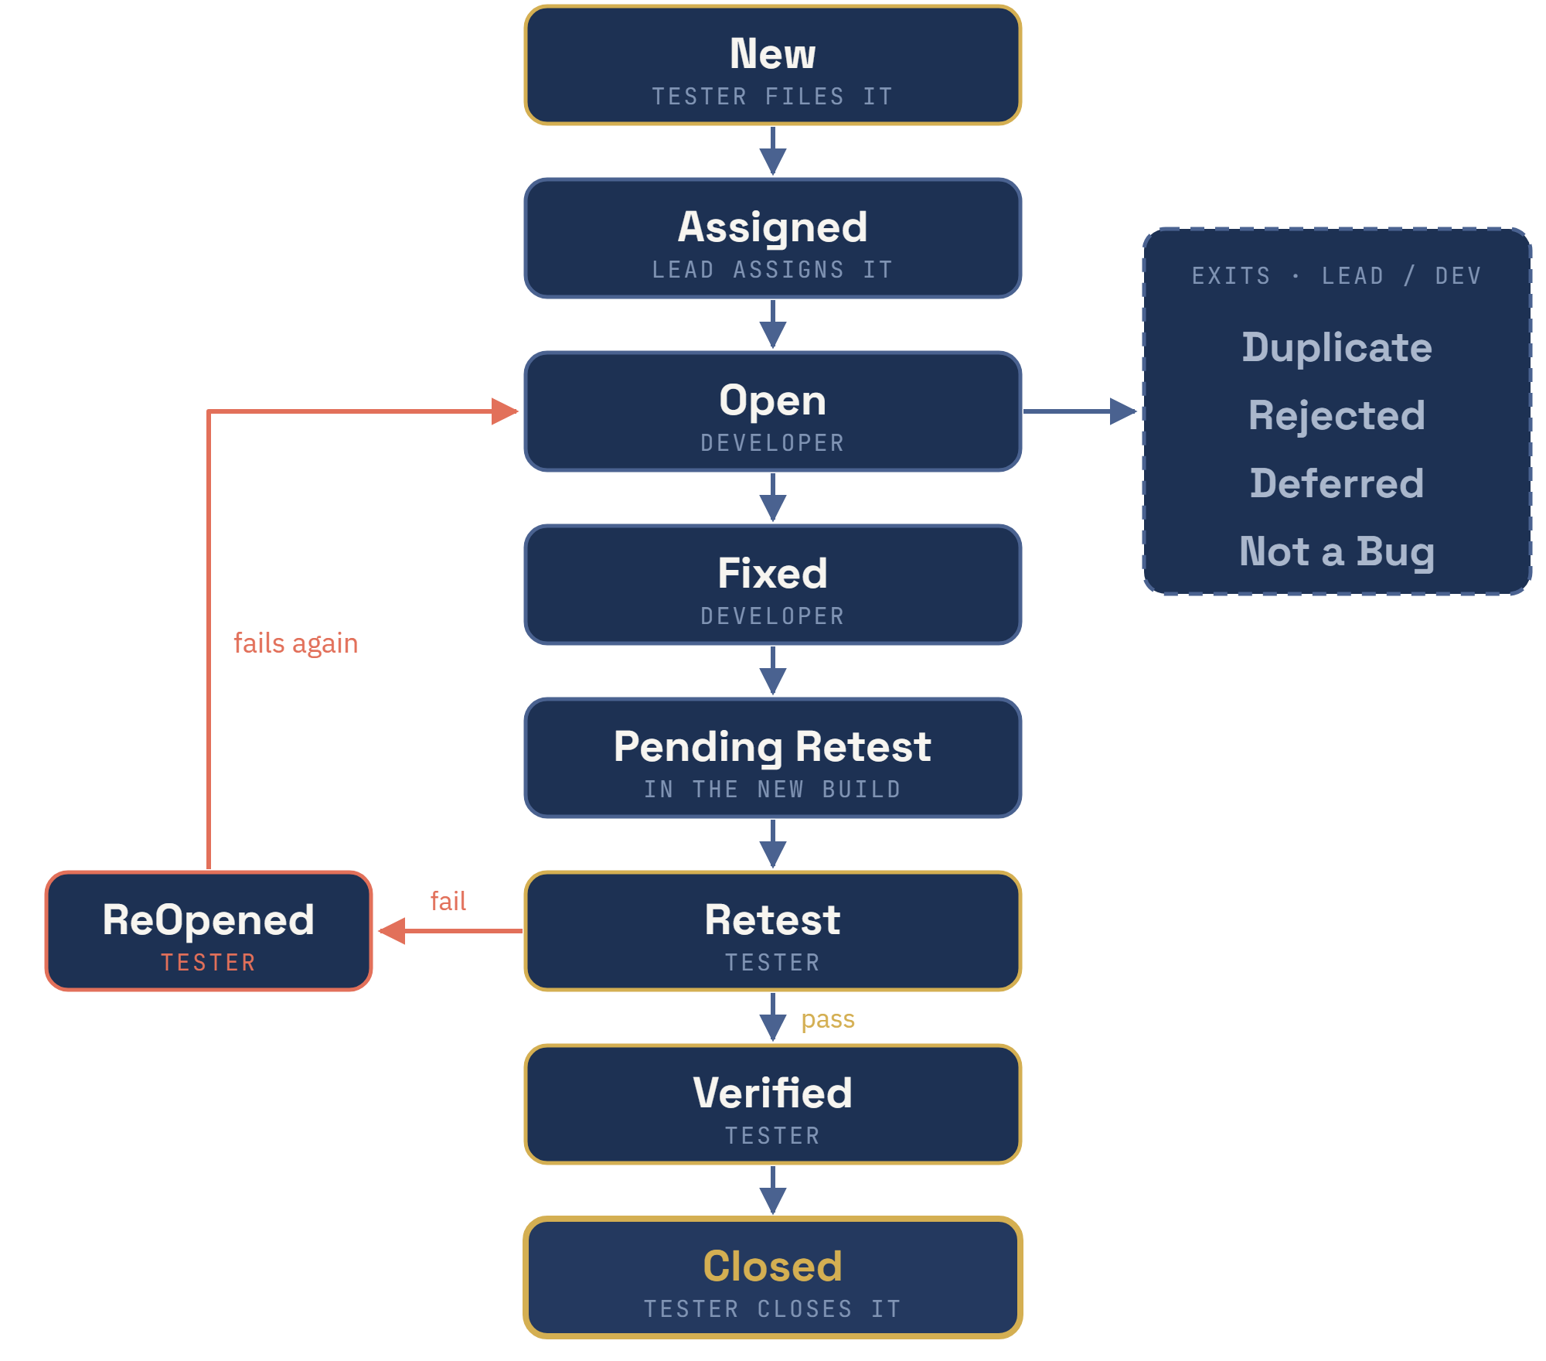
WHERE THE REPORT GOES NEXT
The defect
lifecycle
Each box is a state. The small line under it says who moves it.
■ Gold edge — the tester
■ Blue edge — the lead or the developer
■ Red — retest failed, back to Open
The tester opens it and closes it.

Slide 15
THE LIFECYCLE · THE MAIN PATH · ONE LOGIN DEFECT
Eight states, followed on one defect
STATE | WHAT IT MEANS | WHO | OUR DEFECT: “LOGIN FAILS WITH A VALID PASSWORD”
New | Filed. Nobody has looked yet | Tester | You file it with the five steps from slide 8
Assigned | Accepted and given to a developer | Test lead | The lead reads it and assigns it to the login developer
Open | The developer is working on it | Developer | They follow your steps and see the same failure
Fixed | Code changed. The developer says done | Developer | The password check compared the wrong field
Pending Retest | The fix is in a build, waiting for you | — | Build 2.4.1 is on the test server
Retest | Same steps, new build | Tester | You repeat steps 1 to 5 exactly
Verified | The defect is gone | Tester | testuser / Test@123 logs in
Closed | Nothing left to do | Tester | You close it — not the developer
Fixed is a claim. Verified is evidence. Only the second one closes a defect.

Slide 16
THE LIFECYCLE · THE WAYS OUT
Four exits from Open, and one loop back
DUPLICATE
REJECTED
DEFERRED
NOT A BUG
Already reported
“Not a defect”
Real, but not now
Works, just not how you like it
Same defect, or same root cause. Linked to the first report.
Most often: cannot reproduce. Your steps did not work for them.
Low priority or no time. Moved to a later release.
“Make the button blue.” A change request, not a defect.
ReOpened — the retest failed. The defect goes back to Open, to the same developer, with the same report. Not a new defect.
A defect that came back once can come back again. That is why we rerun old tests — regression, from week 1.

Slide 17
WHY REPORTS COME BACK
Five ways to get your report rejected
01
02
03
Cannot reproduce
Not a defect
Duplicate
No steps, or steps that skip a state
No expected behaviour to point at
Somebody filed it last week
04
05
Works as designed
Missing information
You disagreed with the requirement, not with the build
No environment, no build, no evidence
Four of the five are avoidable while you are still typing.

Slide 18
DO IT NOW · FIVE MINUTES
Report the screen you already broke
THE SCREEN
YOU ALREADY DID THE HARD PART
Week 2, the confirmation page
You found it in nine seconds
A red × above the words “Order confirmed!”
Now write it so Cairo can fix it without calling Shebin
Write Title, Steps, Expected, Actual. Four lines. Then swap with the person next to you and try to act on theirs.
If you have to ask them a single question, hand it back.

Slide 19
PART TWO · FIRST, WHAT YOU DID BY HAND
You have run the same four steps eleven times today.
01 · PRECONDITION
02 · EXECUTE THE STEPS
03 · COMPARE
04 · REPORT
Get to the starting state
Do the steps, in order
Expected against actual
Pass, or file a defect
Logged out, on the login page, testuser exists
Type the username and password, click Submit
Should see the dashboard. Did you?
Write the result down, every single run
That is manual testing: a person does all four, by hand, every time.
Now you teach the browser to run them.

Slide 20
WHAT AUTOMATION IS FOR
Not to find bugs. To re-find them.
A HUMAN IS BETTER AT
A MACHINE IS BETTER AT
Seeing what looks wrong
Running the same thing for the hundredth time
The red × over “Order confirmed”. No script catches that.
At 3am, identically, without getting bored
Automation does not replace the tester. It replaces the eleventh time the tester runs the same four steps.
That is regression testing — the thing we named in week one and never automated.

Slide 21
THREE THINGS THAT ARE NOT TRUE
Automation myths
MYTH
MYTH
MYTH
“Automate everything”
“It is cheaper”
“No more manual testers”
Every script is code you now have to maintain
Cheaper on run two hundred. Much more expensive on run one
Somebody has to decide what the script should assert
A test suite is a second product. It has its own defects, and nobody writes a defect report for it.

Slide 22
WHEN EACH ONE WINS
Manual or automated?
The job | Who does it
Checking a screen you have never seen before | Manual
Running 200 login cases every night | Automated
Judging whether a layout looks wrong | Manual
Re-running the cart suite after every commit | Automated
Testing a feature that changes every two days | Manual
The last row is the one teams get wrong. Automating a moving target costs more than running it by hand.

Slide 23
THE TOOL
What Selenium actually is
IT IS
IT IS NOT
A library that drives a real browser
A testing framework
Your Java code tells Chrome what to do, as if a person did it
It has no assertions and no reports. TestNG does that.
Selenium opens the browser, finds elements and clicks them. Deciding whether the result is right is still your job.
That is why week one said Selenium is black-box: you drive the interface, you never read the application's code.

Slide 24
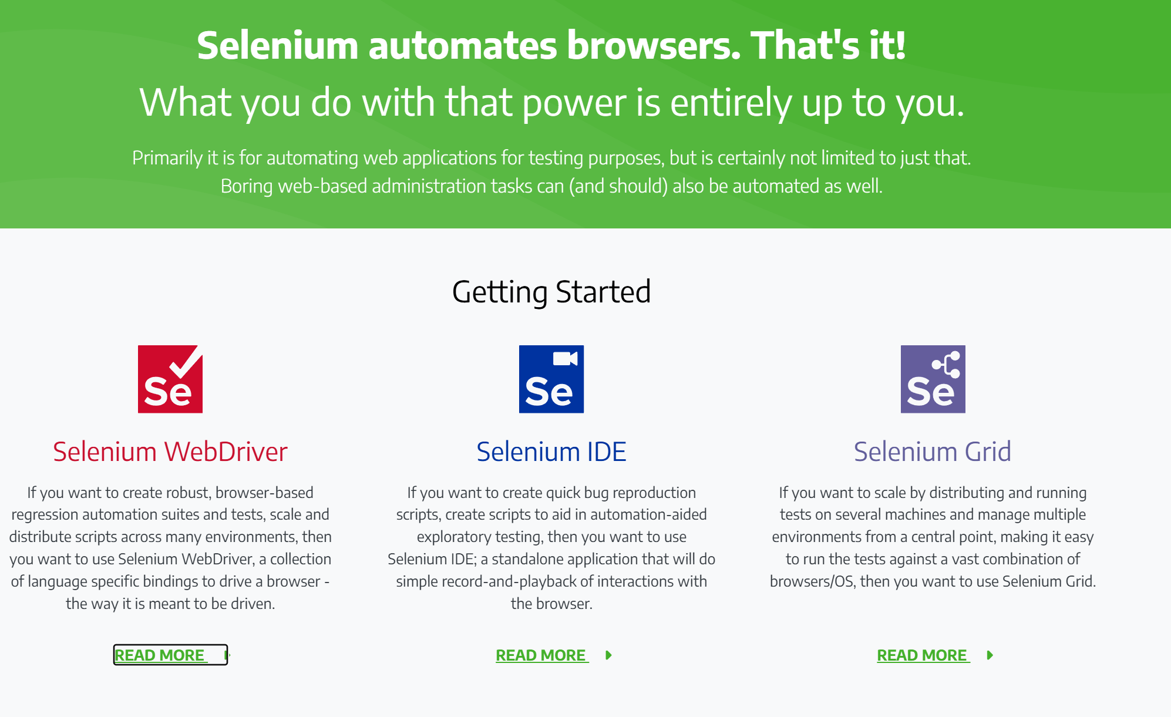
THE TOOL · SELENIUM.DEV
One name,
three tools
The project's own home page. Read the three columns.
Same name, three different jobs.
We use WebDriver. The other two you should recognise.

Slide 25
THE TOOL · WHICH ONE, WHEN
WebDriver, IDE and Grid
 | WEBDRIVER · WE USE THIS | IDE | GRID
What it is | A library in Java, Python, C#… | A Chrome or Firefox extension | A server that spreads tests out
How you use it | You write code | You click; it records, then plays back | You send WebDriver tests to it
Best for | Regression suites that last | Reproducing a bug quickly | Many browsers and machines at once
Needs code? | Yes | No | Yes — WebDriver code
Weak point | You must program | Breaks when the page changes; little logic | Machines to set up and run
In this course | Every week from now | Not used | Not used
Grid does not replace WebDriver. It runs WebDriver tests on many machines at the same time.
Selenium IDE is not IntelliJ. One records clicks in the browser; the other is where you write WebDriver code.

Slide 26
BEFORE ANY CODE RUNS
Four things in the project
01
<dependencies>
Java JDK
<dependency>
<groupId>org.seleniumhq.selenium</groupId>
<artifactId>selenium-java</artifactId>
<version>4.43.0</version>
02
</dependency>
An IDE
<dependency>
<groupId>org.testng</groupId>
IntelliJ IDEA
<artifactId>testng</artifactId>
<version>7.12.0</version>
</dependency>
</dependencies>
03
A Maven project
Maven downloads them for you. You never put a .jar in a folder by hand.

Slide 27
YOUR FIRST SCRIPT
Six lines that open a browser
public class FirstProject {
@Test
public void openTheShop() {
WebDriver driver = new ChromeDriver();
driver.get("https://www.saucedemo.com/");
System.out.println(driver.getTitle());
driver.quit();
}
}
new ChromeDriver()
driver.get(url)
driver.quit()
Opens Chrome
Goes to the page
Closes it and ends the session

Slide 28
⚠ A REAL DEFECT, IN YOUR OWN COURSE MATERIAL
Two browsers open. Why?
public class firstproject {
LINE 3
Opens Chrome when the class is built
WebDriver driver = new ChromeDriver();
@BeforeTest
public void prepare() {
LINE 7
driver = new ChromeDriver();
Opens Chrome again, before the test
}
}
THE RESULT
Two windows. The first one is never closed.
quit() only reaches the second
Now write it up. Title, steps, expected, actual. You have everything you need.

Slide 29
MOVING AROUND
Navigation and window methods
driver.get(url);
driver.manage().window().maximize();
driver.navigate().to(url);
driver.manage().window().minimize();
driver.navigate().back();
driver.manage().window().fullscreen();
driver.navigate().forward();
driver.manage().window().setSize(d);
driver.navigate().refresh();
driver.manage().window().setPosition(p);
THE MYTH
THE TEST
“navigate().to() keeps the history, get() does not”
get(A), get(B), back() → you are on A
back() works after get() too. Inside Selenium, to() just calls get()
You will hear it in interviews and read it online
Same command, two names. The right interview answer: no difference — navigate() only groups to, back, forward and refresh.

Slide 30
READING THE PAGE
Getting information back out
String url = driver.getCurrentUrl();
String title = driver.getTitle();
String html = driver.getPageSource();
String handle = driver.getWindowHandle();
driver.close(); // this tab
driver.quit(); // the whole browser, and the session
getTitle()
getPageSource()
The one you will assert on
The entire HTML
“Swag Labs” — compare it and you have a test
Useful, but almost never what you want to assert
Week 2 said Selenium would compare an expected string character by character. getTitle() is that string.

Slide 31
WHO SAYS PASS OR FAIL
TestNG runs them, in the order you choose
@BeforeTest public void prepare() { driver = new ChromeDriver(); }
@Test(priority = 1) public void signUp() { }
@Test(priority = 2) public void login() { }
@Test(priority = 3) public void addToCart() { }
@AfterTest public void tearDown() { driver.quit(); }
@BeforeTest
priority
@AfterTest
Opens the browser once
Lower number runs first
Closes it once
Before any test runs
1, then 2, then 3
Even if a test failed
Put the driver in @BeforeTest or in the field — never both. That was the defect two slides ago.

Slide 32
NEXT WEEK
How does the script find the button?
driver.findElement(By.id("user-name")).sendKeys("standard_user");
driver.findElement(By.cssSelector("#login-button")).click();
ID
Name
Class
CSS
XPath
Everything today opened pages. Next week we touch what is on them.

Slide 33
SIX THINGS TO TAKE AWAY
If you remember nothing else
01
02
03
A defect is a gap
Steps decide everything
Severity is not priority
Expected versus actual, with a source
No steps, no fix
Technical versus business
04
05
06
The tester closes the defect
Automation re-finds, it does not find
One driver, one place
Field or @BeforeTest, never both
Never the developer
That is regression
If only two: 02 and 03.

Slide 34
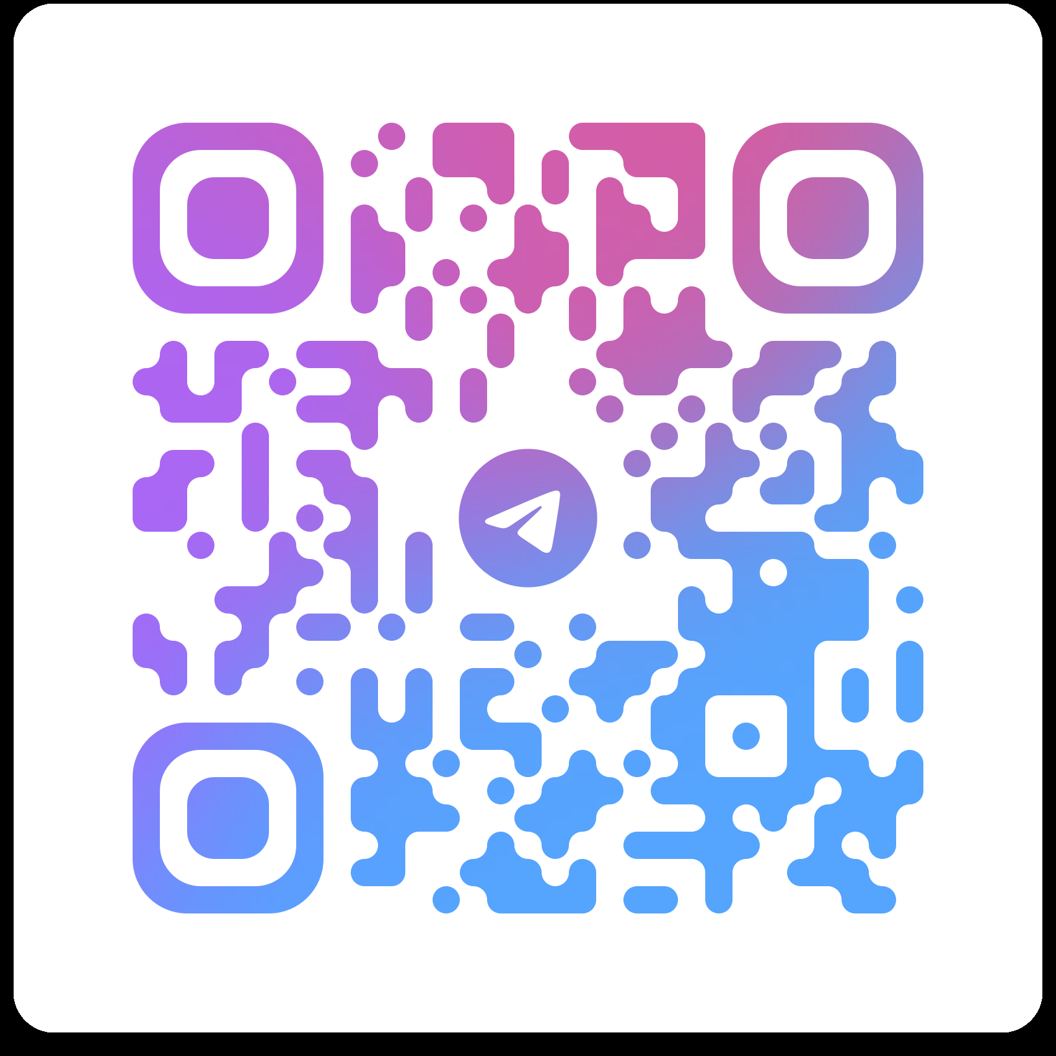
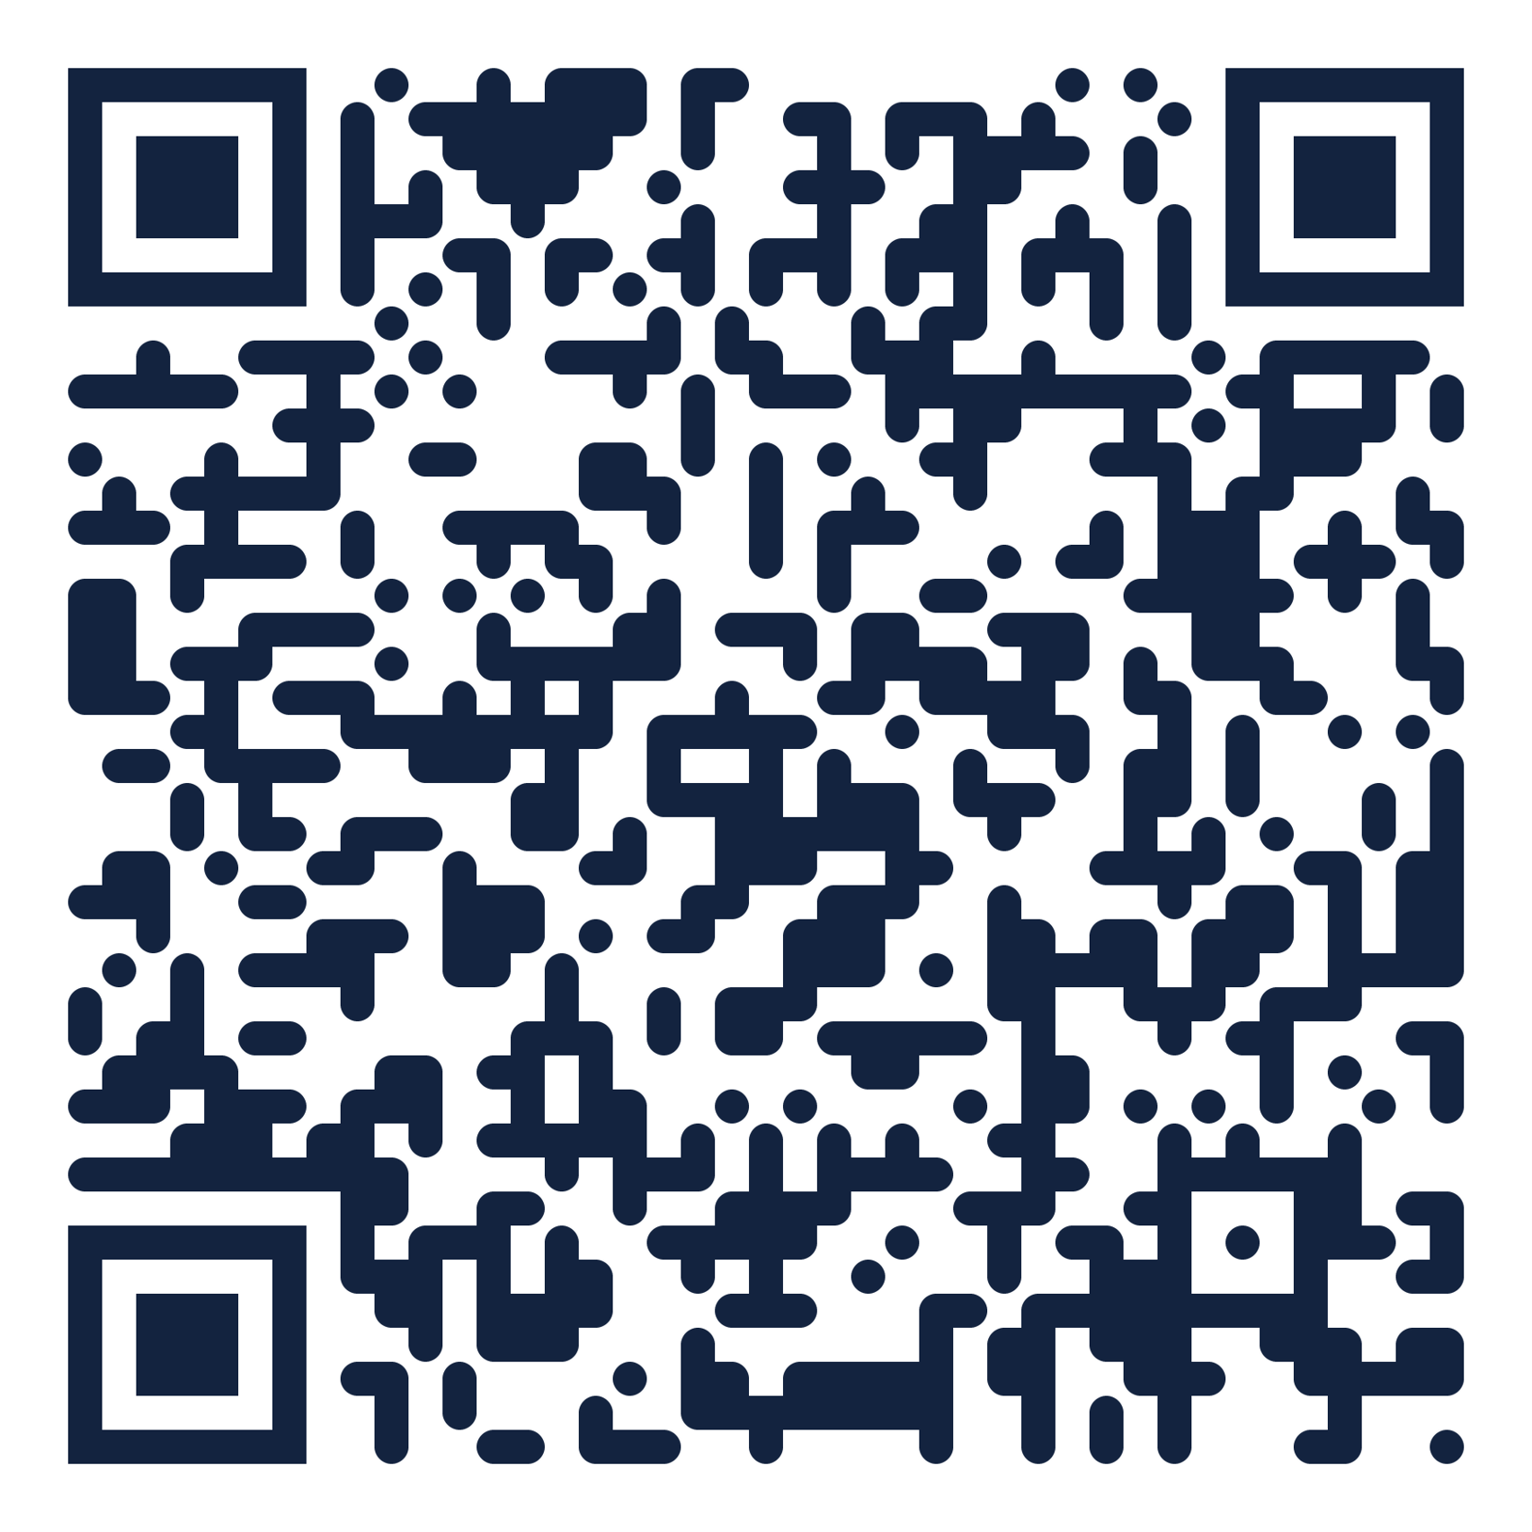
Questions?
CONTACT ME
Eng. Mohamed Shehab
mohamed.shehab.fci@gmail.com
telegram @shebo280
Faculty of Computers and Information
Menoufia University
Telegram group
Recordings
questions between sessions
every session, in order
Software Engineering 2 · Week 3 · Defect Reports and First Selenium Script — this session is video 3 in the playlist
Bring a laptop next week with Java and IntelliJ installed. Week four is hands on keyboards.

